Slide 1
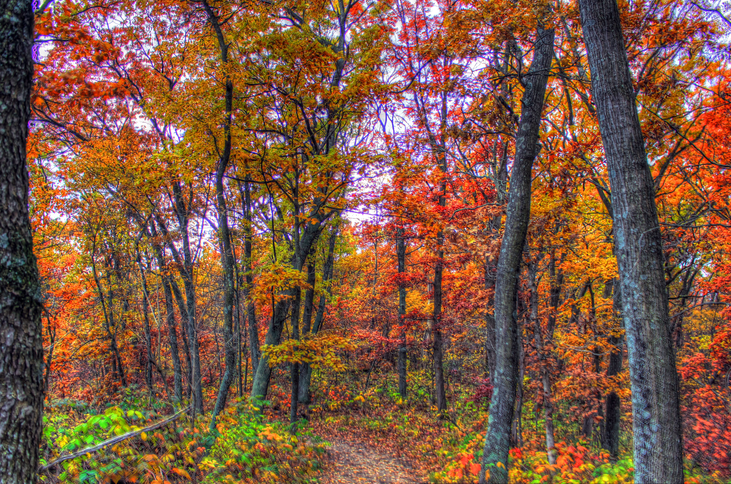
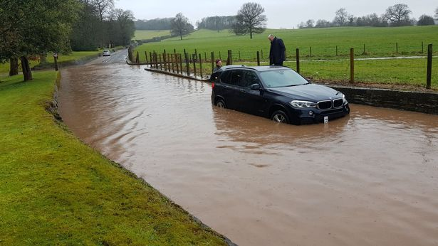
Change the story

Slide 2
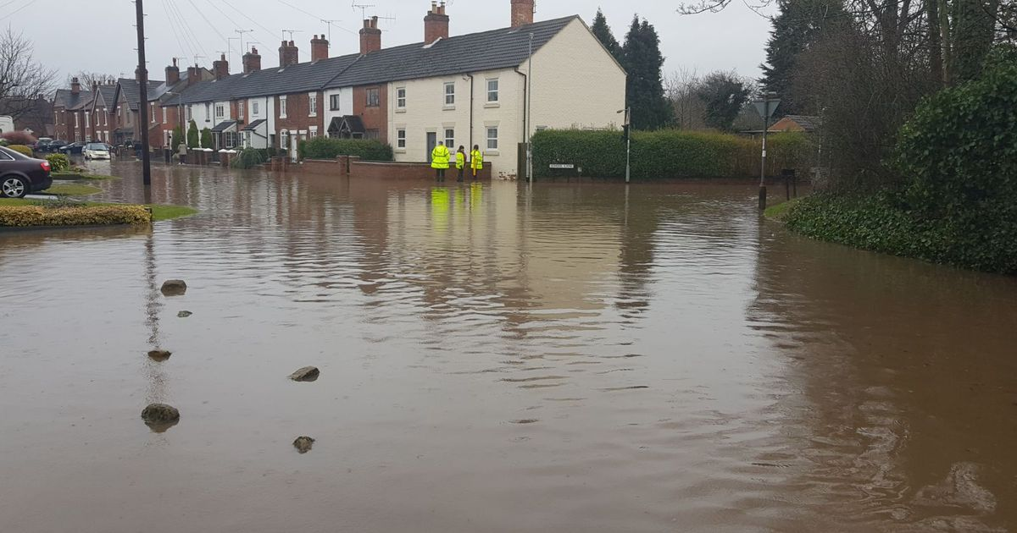
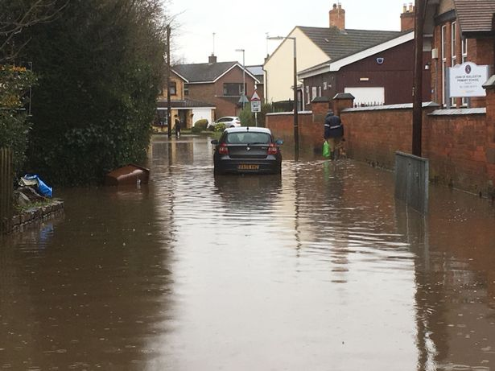
Rolleston floods

Slide 3
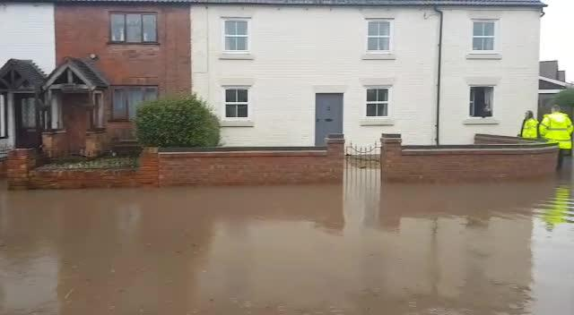
Floods in the Rolleston houses
In Rolleston there has been lots of floods meaning houses are flooding too. This has been happening for years are they are really bad ,they have even been going into gardens.
The damage is bad and has taken months and years to repair.
The water is getting up to car level and is making it hard to drive

Slide 4
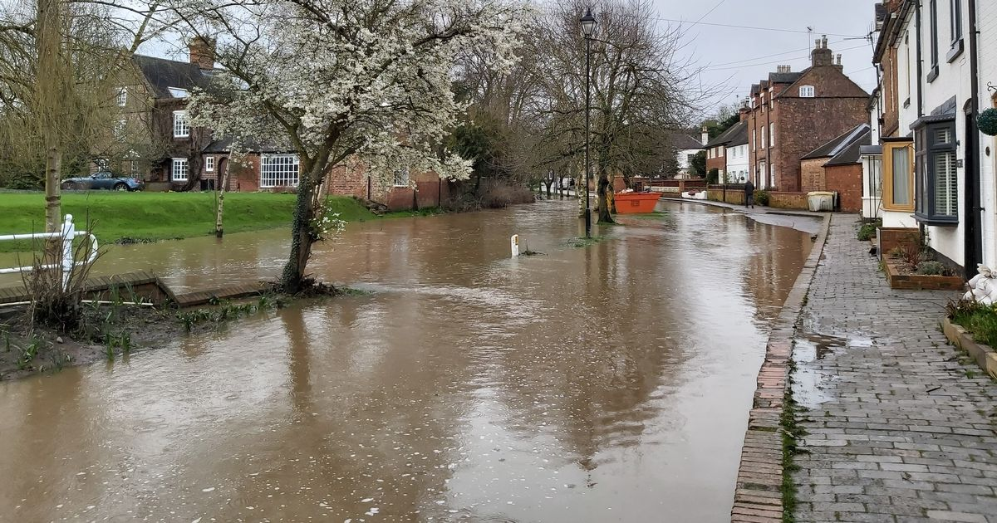
The problem
When it floods in Rolleston we cant go to school with out getting our feet wet.

Slide 5
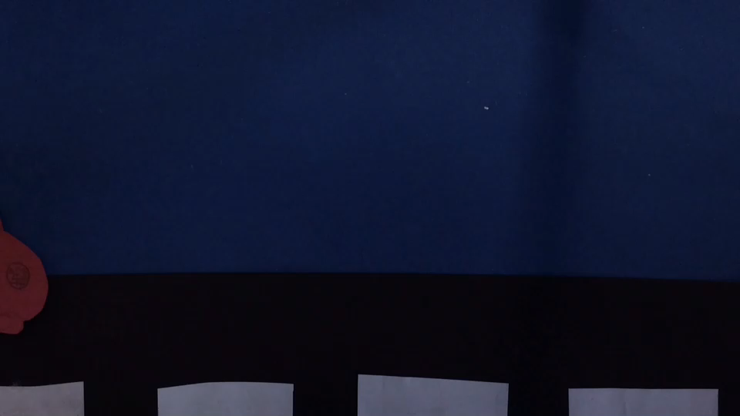
This is what is wrong with our planet
We cant just help the floods there is other things happening that could cause flooding

Slide 6
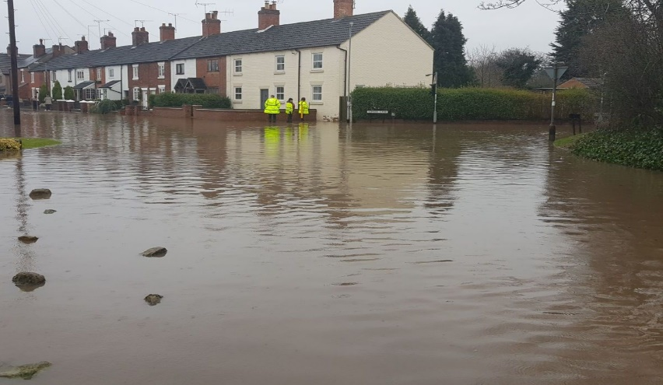
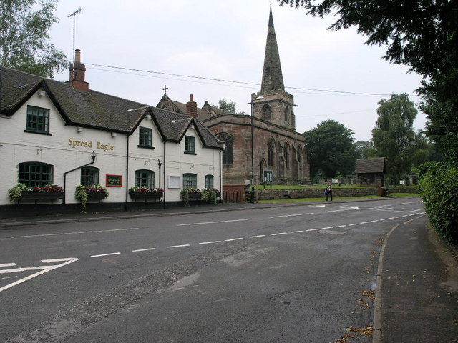
What would happen if this stopped
If the floods stopped we would be able to get to school without getting wet and getting other people wet
To
The floods ruin the place

Slide 7

What would happen if we didn’t help this
If we didn’t help we wouldn’t be able to get to school and houses would be destroyed. The world would be ruined and we wont be able to get around.
The world needs help!

Slide 8
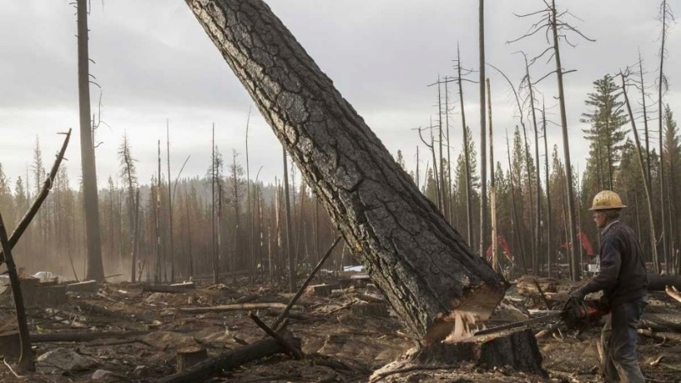
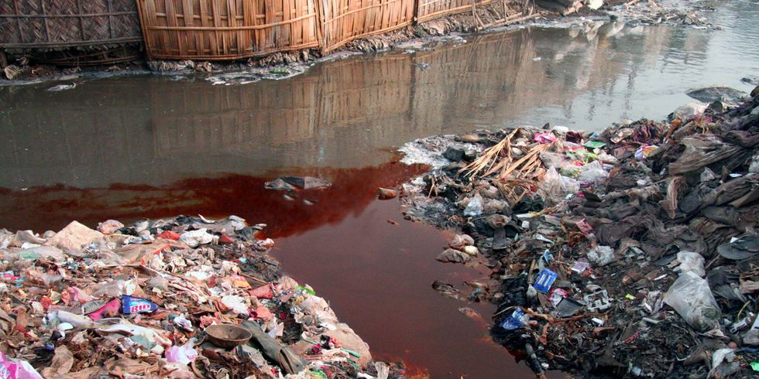
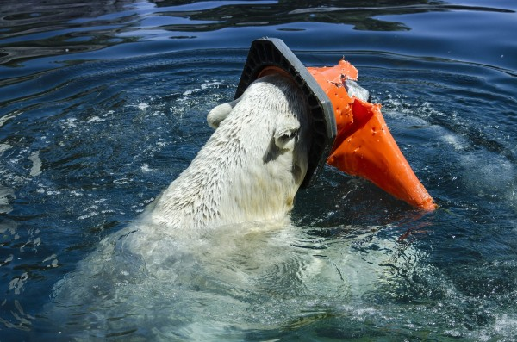
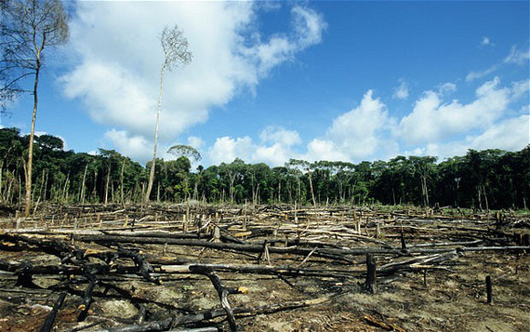
What else happens
flooding
Crops field destroyed
Houses flooding
Forrest fires
Ice caps melting
Animals habitat loosing
Global warming
Storms
Sea levels rise

Slide 9
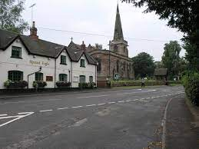
Use solar panels
Eat a vegan diet
Insulate houses
Walk and cycle more
Use electric cars [renewable energy]
Consume less
solutions

